Slide 1
Photomicrographs of Plant foods
Bean: Lupini (Fava)
Permission to reproduce original photomicrographs used to make this collection may be obtained from
Dr. David O. Norris at
david.norris@colorado.edu

Slide 2
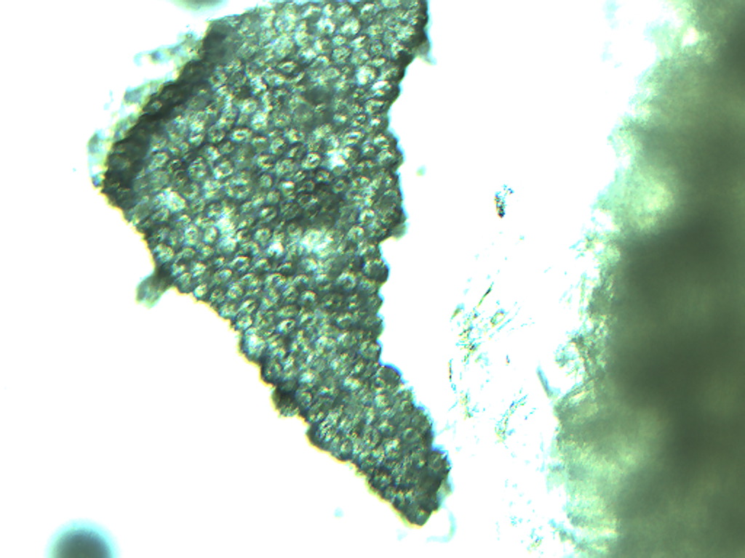
Notes:
68. Vicia sativa L. Bean, lupini (= fava bean). Seed coat fragment (testa), 10X.

Slide 3
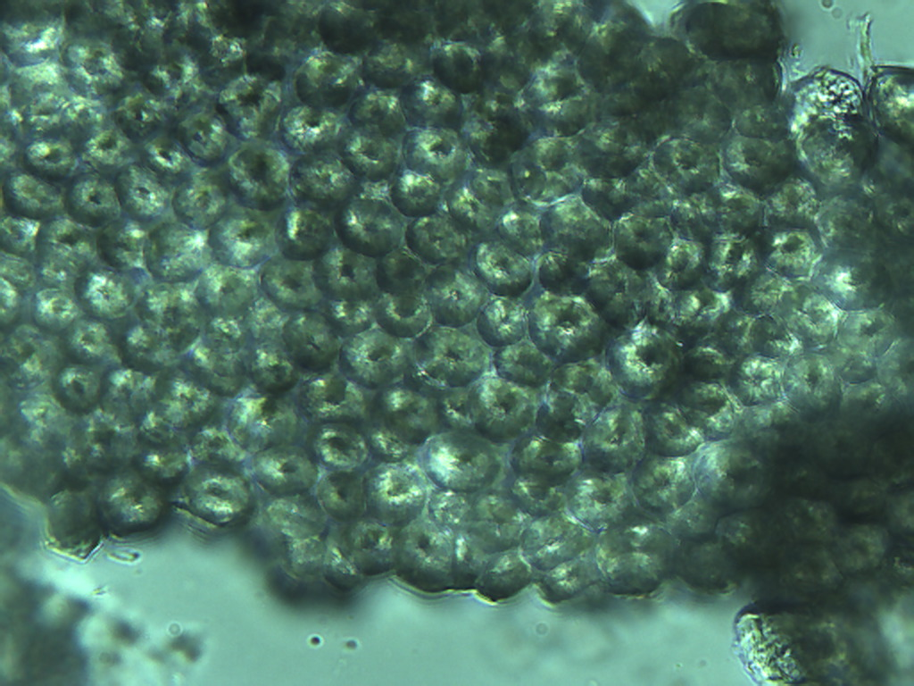
Notes:
69. Bean, lupini (fava). Seed coat (testa), 25X

Slide 4
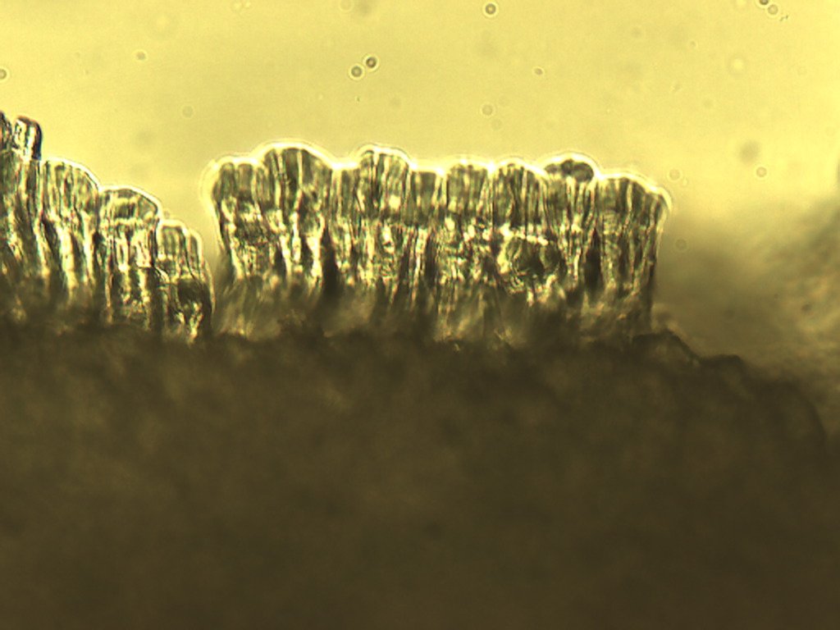
Notes:
70. Bean, lupini (fava). Side view of seed coat showing extreme thickness of these cells resulting in a very tough, inedible seed coat. 25X

Slide 5
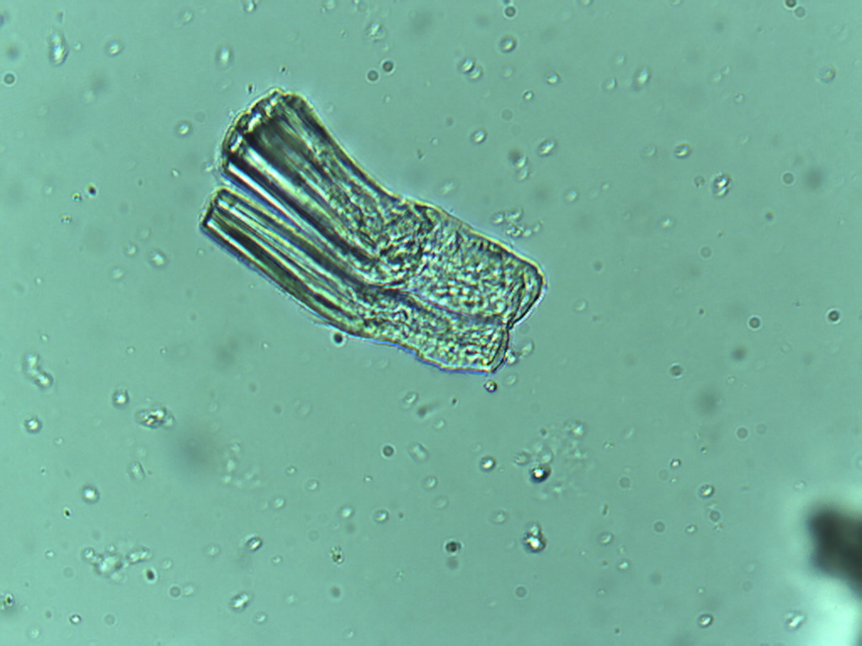
Notes:
71a. Bean, lupini (fava). Isolated seed coat cells, 25X.

